Slide 1
Information type：Confidential Company： NTT DATA Business Solutions SG Information owner：MD
Materials Management Overview
02 Jul 2018
NTT DATA Business Solutions Singapore

Slide 2
INDEX
1
Objective
2
Materials Management Overview
3
Master Data
4
Procurement
5
Inventory Management
6
Batch Management
7
Serial Number Management
8
Invoice Verification

Slide 3
1. Objective
To obtain the general knowledge of the standard SAP MM Process
Select from SAP S/4 HANA Best Practices for MM processes specific to MHI
To facilitate the start of design phase

Slide 4
INDEX
1
Objective
2
Materials Management Overview
3
Master Data
4
Procurement
5
Inventory Management
6
Batch Management
7
Serial Number Management
8
Invoice Verification

Slide 5
2. Materials Management Overview
What is Materials Management ?
An application used to manage and facilitate the end-to-end handling of different types of goods in a company (e.g. sourcing, procurement, storage, stock transfer etc)

Slide 6
2. Materials Management Overview
Overview
Procurement
Inventory Management
Material
Receipt
Transfer
Posting
Material
Issuance
Purchase Requisitions
Purchase Orders
Stock Control / Monitoring
Physical Inventory Counting
Types of purchases include and not limited to
Stock materials
FOC items (e.g. samples)
Consumables
Services
Assets

Slide 7
2. Materials Management Overview
Overview
Materials
Planning
External Procurement
Internal Procurement
Purchasing
Production
Invoice
Master Data
Verification
Inventory Management
Goods
material
issue
batches
vendor
Invoice
G/L accounts
receipt
?
Goods issue
Transfer
customer
posting
warehouses
.
.
Internal and external
Sales and
Internal and external
accounting
distribution
accounting

Slide 8
2. Materials Management Overview
Integration Points with Other Modules
MM
Procurement
PR processing
PO processing
Inventory Management
Goods Receipt
Goods Issue
Stock Transfer
Physical Inventory
SD
FI
Sales and Distribution
Shipping
Billing
Financial Accounting
PP
QM
MRP
Production
Inspection Stock Control for Quality
Vendors
Materials, Purchase Info Record, Source List etc.

Slide 9
INDEX
1
Objective
2
Materials Management Overview
3
Master Data
4
Procurement
5
Inventory Management
6
Batch Management
7
Serial Number Management
8
Invoice Verification

Slide 10
3. Master Data
MM Master Data Overview
Material Master:
Materials that company procures, produces, and stores.
Vendor Master:
Suppliers of the enterprise.
Purchasing Info Record:
Contains the material-vendor relationship and precise procurement information.
Source List:
Determine the source of supply.

Slide 11
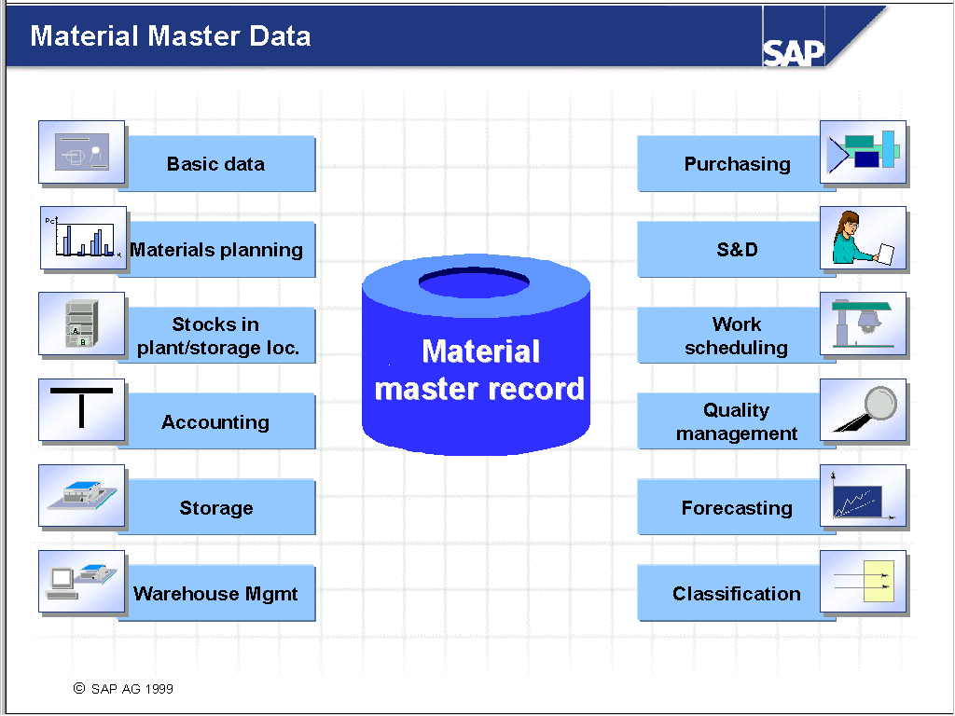
3. Master Data
Material Master Overview

Slide 12
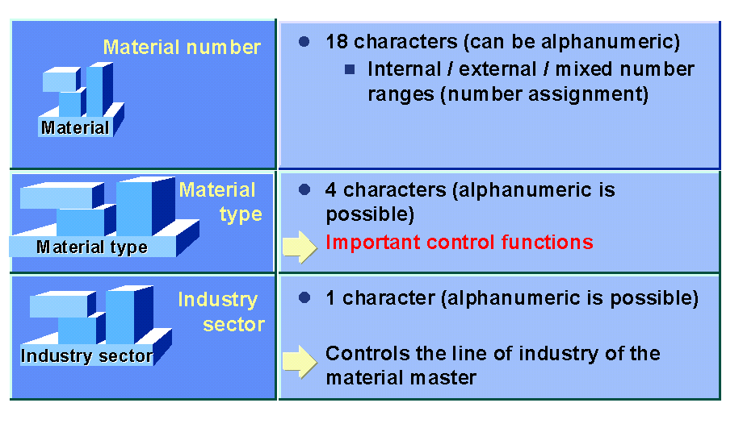
3. Master Data
Material Key

Slide 13
3. Master Data
Material Master Features
Operation: Create, Block, Delete, Change
Central repository of material information
Searching facility by description, group, material type, etc
Classification System
Standard or Moving Average Price

Slide 14
3. Master Data
Material Valuation Procedure

Slide 15
3. Master Data
Unit of Measure

Slide 16
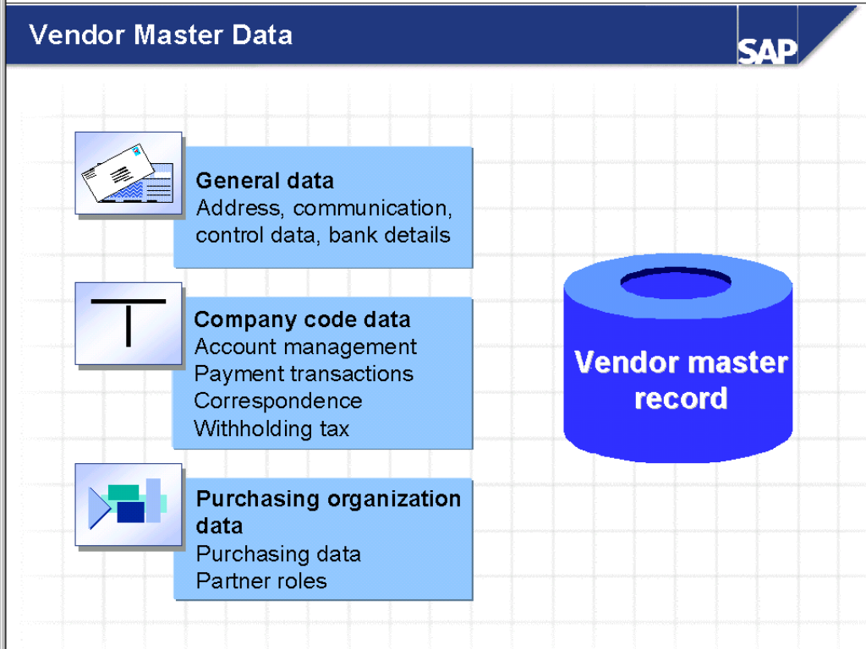
3. Master Data
Vendor Master Data

Slide 17
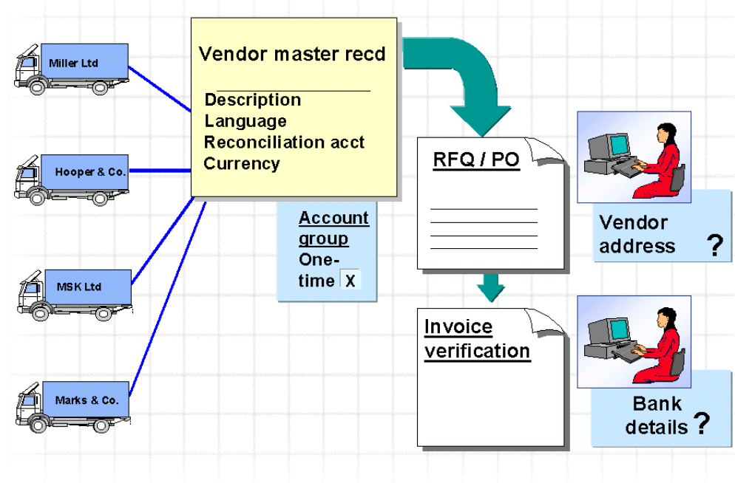
3. Master Data
One Time Vendor

Slide 18




3. Master Data
Purchasing Info Record + Source List
Material Master
Vendor
FG
SFG
RM
Purchase Info Record
Source List
RM 1
RM 1
RM 1
RM 2

Slide 19
3. Master Data
Purchasing Info Record
Pc.
Pc.
%
%
Conditions
Conditions
$
Purchasing
$
Info record
Vendor A
Info record
Stock material M1
Info record
Consumable material M2
Info record
Vendor B
Info record
Service D1

Slide 20
3. Master Data
Source List

Slide 21
INDEX
1
Objective
2
Materials Management Overview
3
Master Data
4
Procurement
5
Inventory Management
6
Batch Management
7
Serial Number Management
8
Invoice Verification

Slide 22
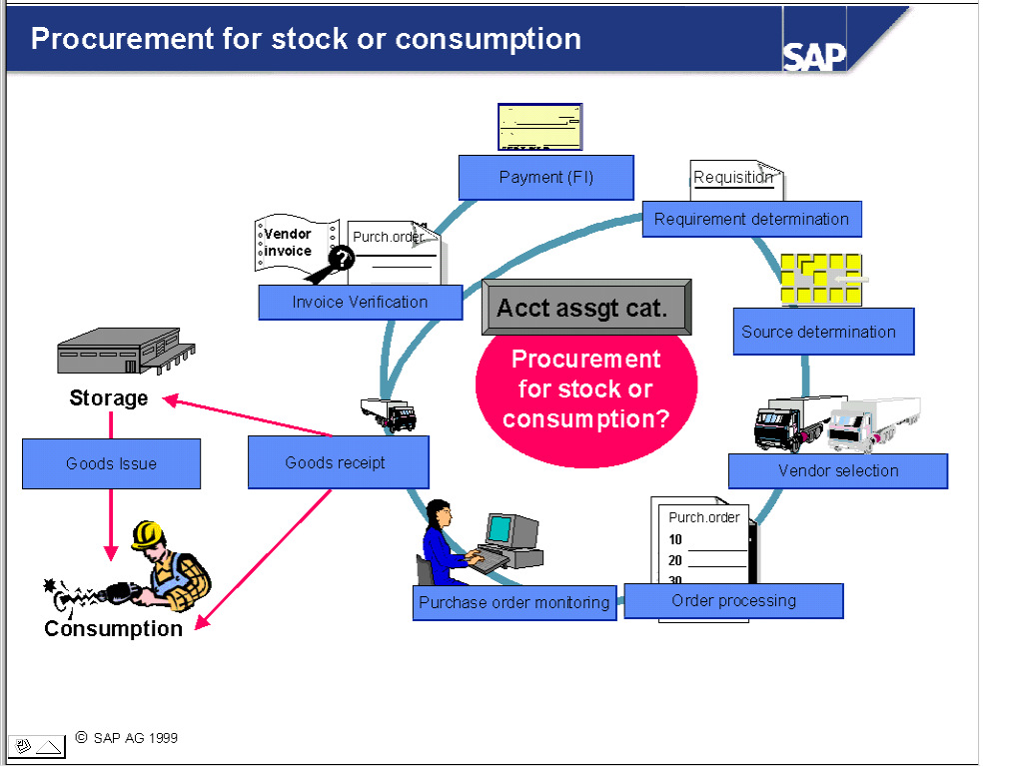
4. Procurement
Purchasing Overview

Slide 23


4. Procurement
Overview
Demands
Create manually or via MRP
Purchase Requisition
Source determination
Purchase Order
Print/fax/email etc

Slide 24
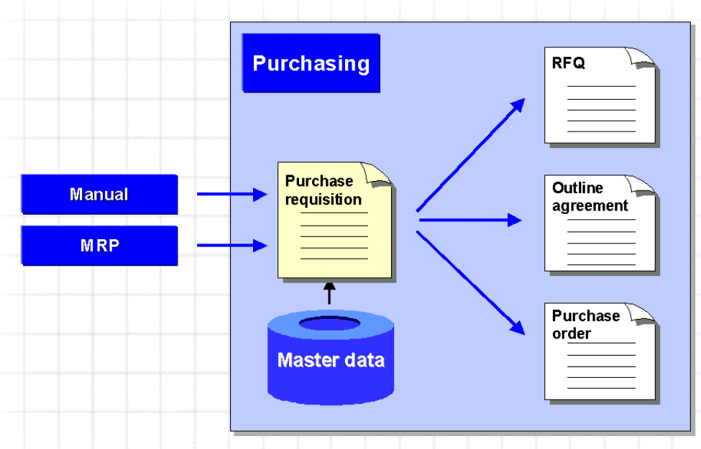
4. Procurement
Purchase Requisition

Slide 25
4. Procurement
Purchase Requisition
Creation:
Directly: PR entered manually
Indirectly: Via other SAP components I.e.: Material Requirements Planning, Third Party sales order
Can be subject to a release/ online approval.
Procurement type: Standard, Subcontract, Consignment, Stock Transfer, External Service
Item can be charged to: Inventory, Cost Center, Asset, Internal Order, etc.
Split to multiple POs, combined to one PO if buying to same vendor.

Slide 26
4. Procurement
Request for Quotation
RFQ
!
Quotation price
comparison list
Manual/automatic
data update
One-time vendor
Certificates
Statistics
Quantities
Reminder
Texts
Conditions
Purch. info record
Vendor B
Purch. order
RFQ
Rejection
?
Collective request
for quotation
Purch. order
Stock material
Consumable material
Service
BANF
Purch. req

Slide 27
4. Procurement
Purchase Order
Reference and
copy function
Account
assignment
- Single
- Multiple
Stock material
Consumable material
Service
PURCHASE ORDER
- Normal
- Subcontracting
- Consignment
- Third-party
- Stock transfer
- Text
Contract
Purch. order
Material provided
Purch. info rec.
Req. for quot.
?
Generation from
purchase requisition
processing
Statistics
Direct
entry
Purchase
order history

Slide 28
4. Procurement
Purchase Order
Document Type: Standard, Contract (blanket order), Subcontract, Asset etc.
Can be subjected to a release/online approval
Purchase Order History tracking is available at item level. E.g. Goods Receipt/Invoice information.
Conditions (freight, discount, etc.) can apply at various level: header, item, service details
Item Category: Standard, Subcontract, Consignment, Stock Transfer, External Service
Item can be charged to: Inventory, Cost Center, Asset, Order, Project etc.

Slide 29
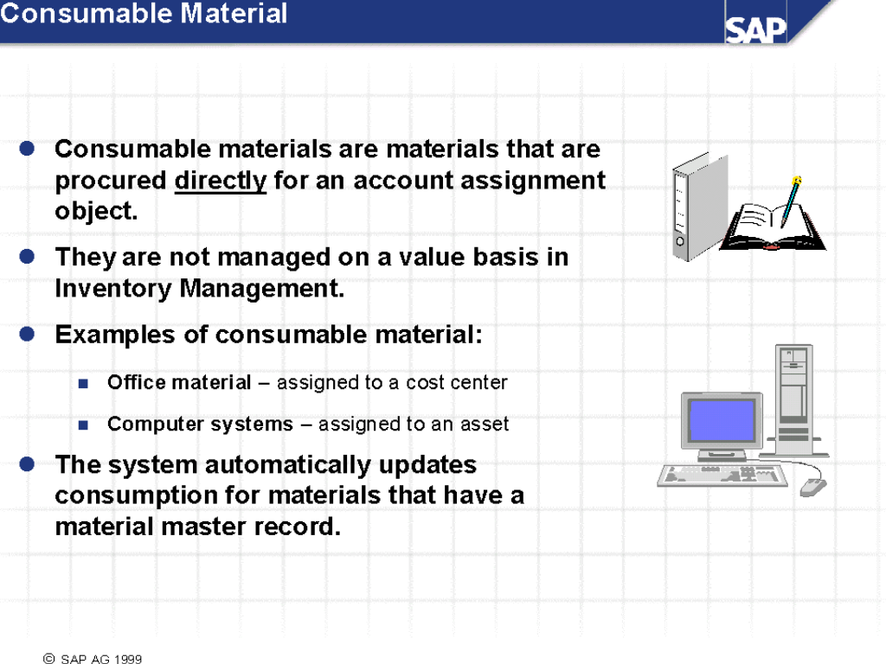
4. Procurement
Types of Purchases - Consumables

Slide 30
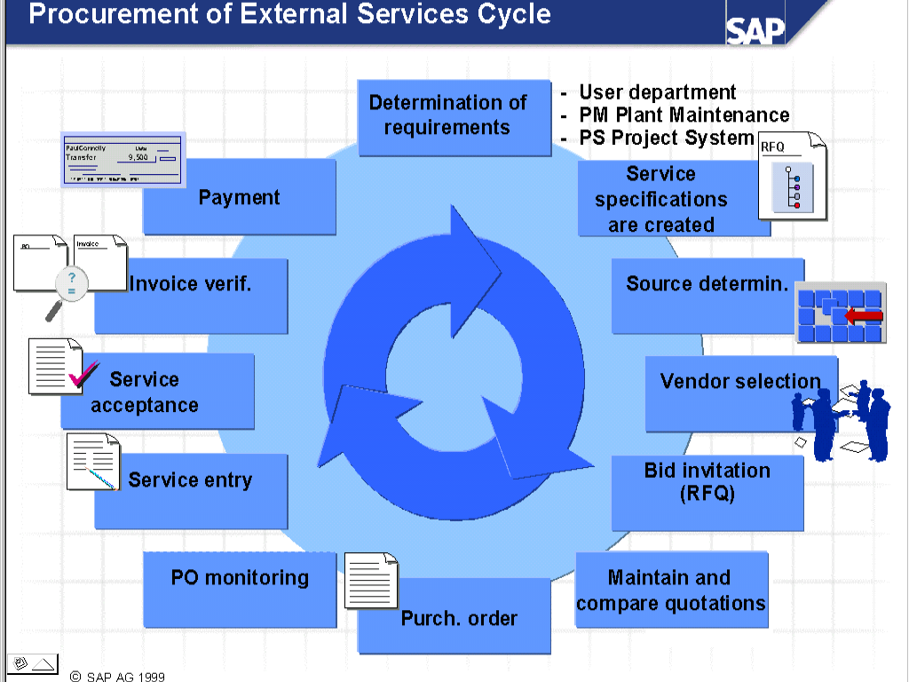
4. Procurement
Types of Purchases - Services

Slide 31
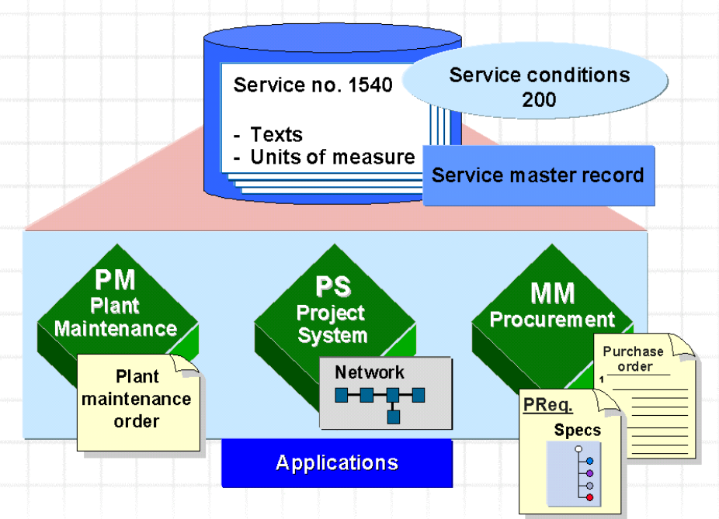
4. Procurement
Service Master

Slide 32
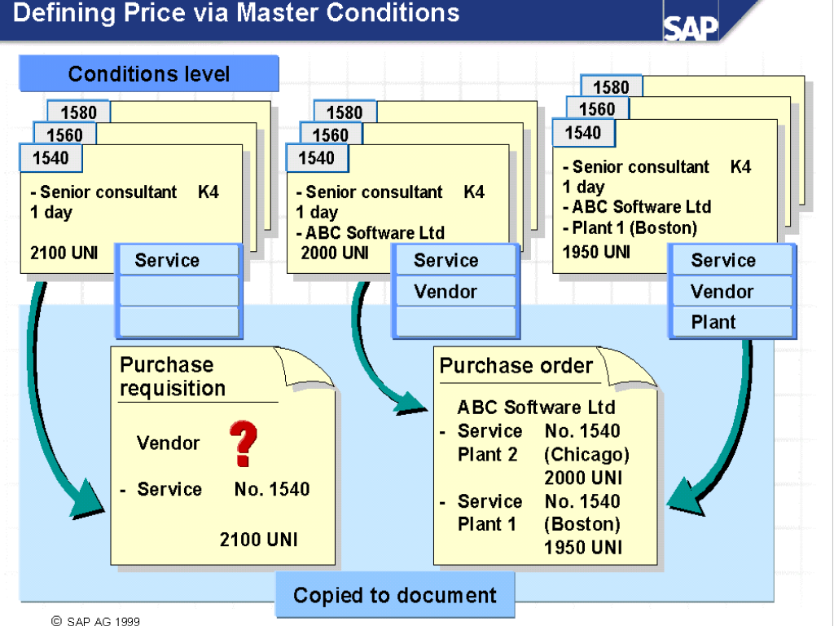
4. Procurement
Service Master Conditions

Slide 33
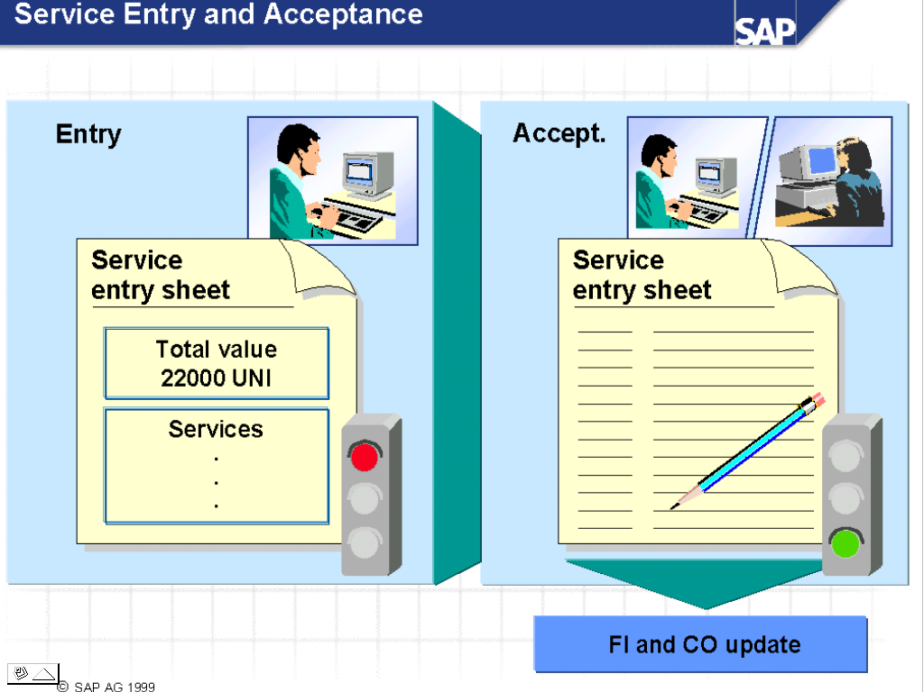
4. Procurement
Service Entry and Acceptance

Slide 34
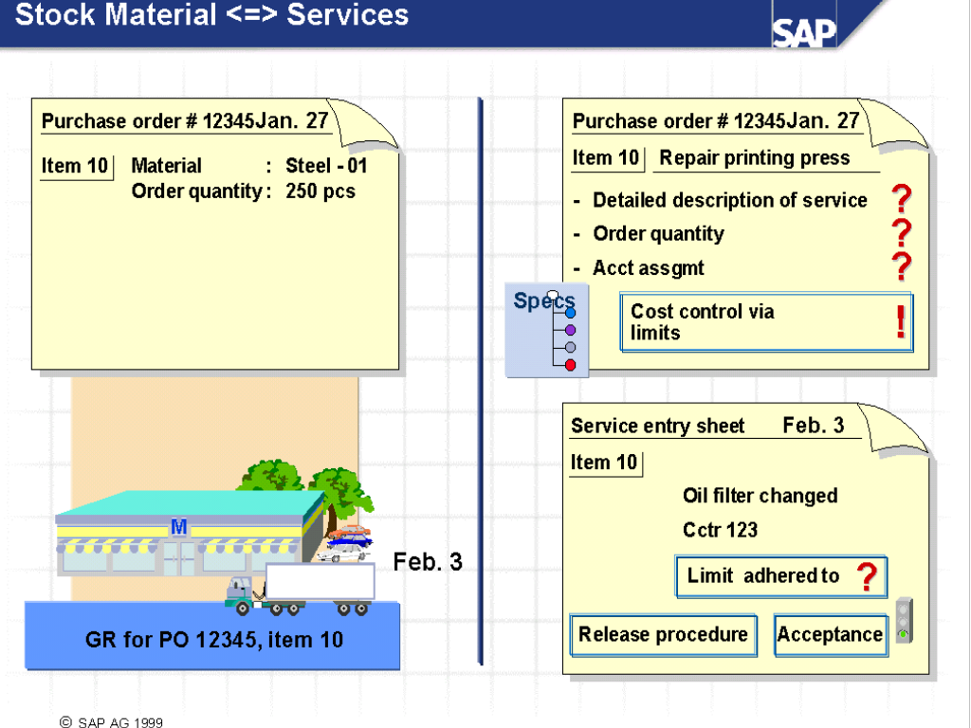
4. Procurement
Stock Materials vs Services
Notes:
Stock materials are subject to inventory management, whereas services are procured for direct consumption.
As well as the other account assignment categories, you can use the account assignment category U (unknown) for service items, as the account assignment is often not yet definite when the goods are ordered.
When you procure materials, you already know a lot of information, such as the exact order quantity.
When you procure services, however, you often do not yet know the exact service description or the order quantity (for example, when a printing press needs repair, you do not know whether the vendor just needs to adjust settings or whether he or she has to replace parts). You often do not know how long it will take or can only give an estimate. To control the costs, you can define value limits.

Slide 35
INDEX
1
Objective
2
Materials Management Overview
3
Master Data
4
Procurement
5
Inventory Management
6
Batch Management
7
Serial Number Management
8
Invoice Verification

Slide 36
5. Inventory Management
Functionality
Function :
Management of Material Stocks by quantity and value
Planning, data entry and documentation of all goods movement
Physical Inventory
Managing Special Stock
Sales Order Stock (Special Stock type “E”)
Consignment (Vendor Consignment – N/A for MHI)
Subcontracting (15th Nov Wednesday)

Slide 37
5. Inventory Management
Overview
Consumption statistics
Quantity and values
Dec 95
Movement
in-/outward
Stock transfer
Transfer post.
...
Goods receipt
Stock
Goods
receipt/
issue slip
Inventory
Storage location stock
Warehouse mgmt
Storage bins
Special stock
Analysis/ inventory controlling

Slide 38
5. Inventory Management
Goods Movements
Goods Movement Types:
Goods Receipt: Vendor, Production.
Goods Issue: Consumption, Cost Center, etc.
Stock Transfer: Storage Locations, Plants, Companies
Transfer Posting: Material to Material, Own Stock to Stock for Subcon
Result of Goods Movement:
Material Document
Accounting Document
Stock quantities are updated
Stock values in materials master are updated

Slide 39
5. Inventory Management
Example: Production Order Goods Movements
Warehouse
Production Order
Goods receipt
Order header
Assembly
Operations
4
Components
Finished goods or assemblies
PRTs
Costs Material
Labor
...
100
20
Component 1
50
Goods issue
Component 2
1
Material warehouse /
Production Line Location
2
3
Goods issue /
Backflush
Goods Transfer

Slide 40
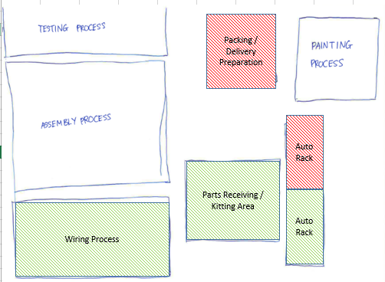
5. Inventory Management
Goods Movements in MHIESA
MHISEA Shopfloor
@ 3 Tuas Ave 12
Completed Gen Set Storage location
Goods receipt from Production order
Goods issue to Production order (backflush)
Legend:
Goods issue to Production order (first issue)
receive
Transfer
Prd will issue collection note for 3PL to collect
Stock trnfr sloc to sloc
Issue
Plant to Plant Transfer
Ops issue DO email to 3PL for alternator / engine. (usually one day in advance)
Stock trnfr sloc to sloc (material stagimg)
Goods receipt from Purchase order (all others)
External Warehouse
@ Gul
Parts warehouse @ Bulim
Suppliers
Goods receipt from Purchase order (alternator / engines)
Goods receipt from Purchase Parts
Post Goods Issue (Sell)
Customer

Slide 41
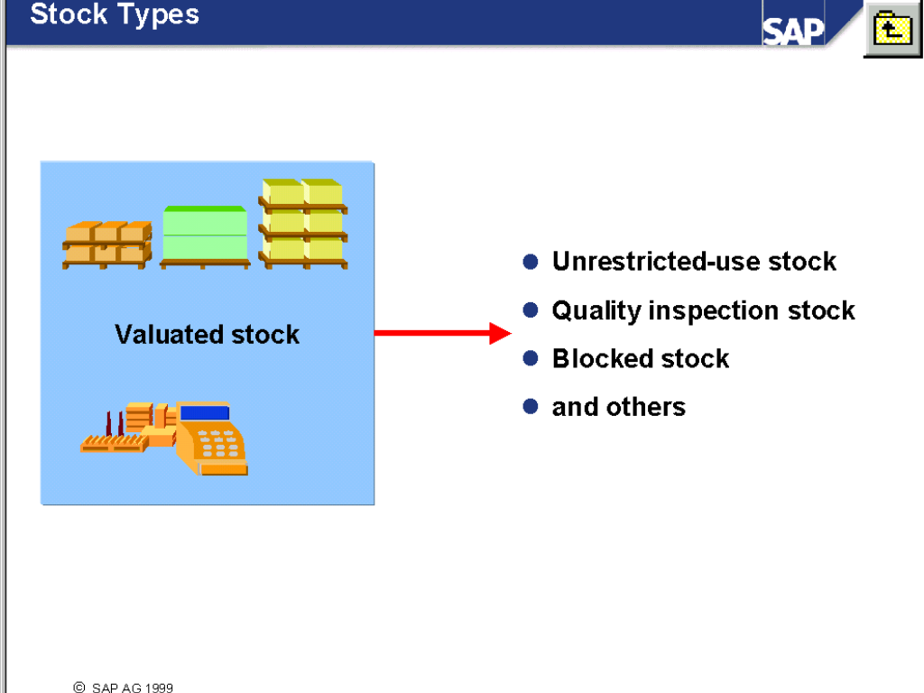
5. Inventory Management
Stock Type

Slide 42
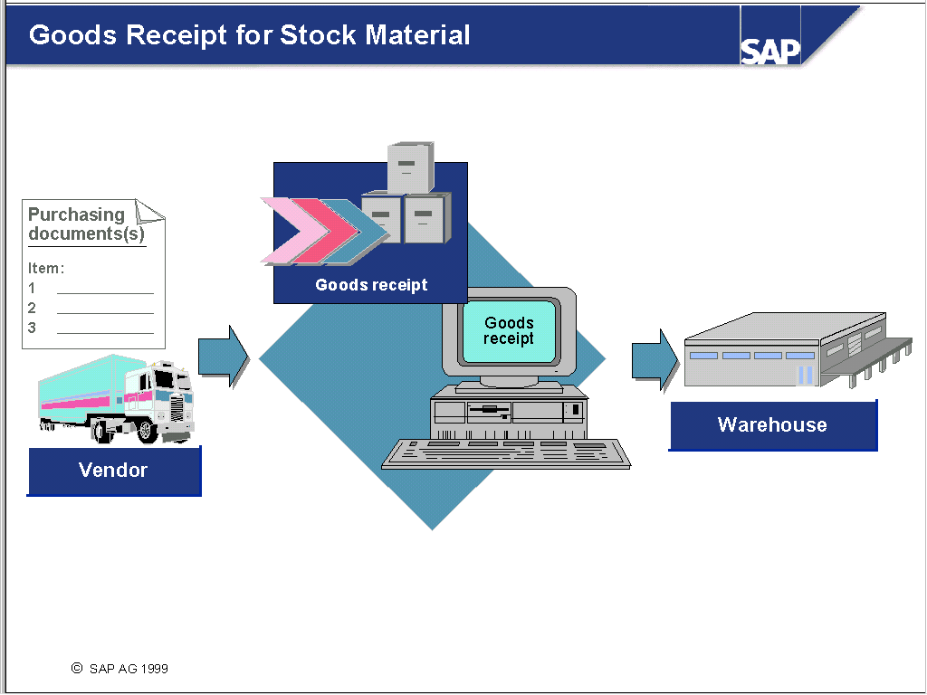
5. Inventory Management
Goods Receipt for Materials

Slide 43
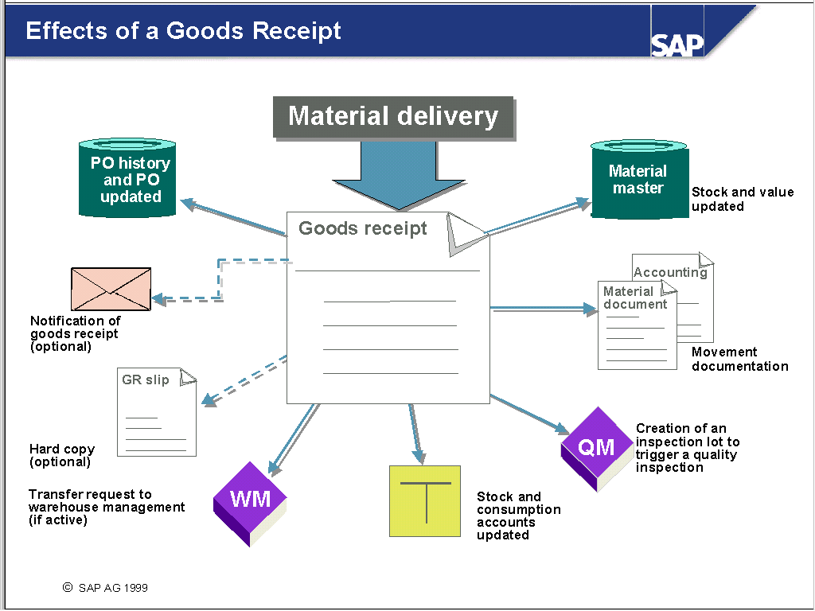
5. Inventory Management
Effects of Goods Receipt

Slide 44



5. Inventory Management (3-Way Match)
Invoice Receipt
Against PO
Goods Receipt
Against PO
GR-Based IV
Sequence of Event | Goods Receipt | Invoice Receipt
PO → GR → LIV | GR Qty vs PO Qty | LIV Qty vs GR Qty LIV price vs PO price
PO → LIV → GR | GR Qty vs PO Qty | LIV Qty vs PO Qty LIV price vs PO price
Debit Stock
Credit GR/IR
Debit GR/IR
Credit Vendor Acct

Slide 45
5. Inventory Management (3-way match)
Scenario | Possible outcome
Matching PO Qty + pricing in either full or partial shipment | Ideal Case
Qty discrepancy (either short-ship or excess delivery) | If shortage/damage, follow up with supplier for debit note or replacement. If excess, follow up with supplier for RTV and/or credit note.
Pricing discrepancy | If GR is not performed yet, change PO to reflect actual pricing. Else, there will be a price difference posting. Also possible to post subsequent credit/demo note against PO.

Slide 46
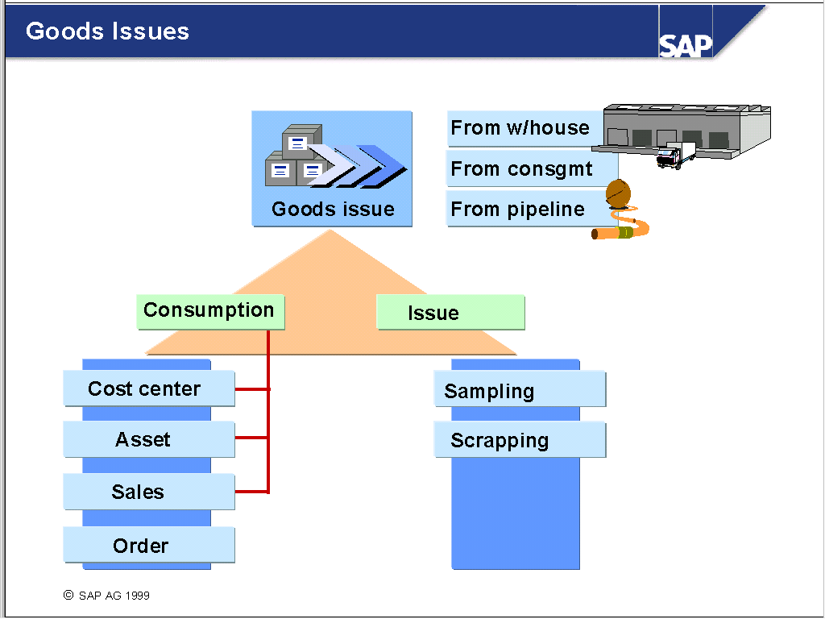
5. Inventory Management
Goods Issue
Notes:
Goods issues can be planned or unplanned. The data to be entered depends on the type of goods issue. The R/3 System prepares various account assignment fields, depending on the movement type and system configuration. It uses automatic account determination to determine the G/L account to which the movement is posted. You enter a G/L account only if you want to post the goods movement to another account.
If a material is no longer of use, it is posted for scrapping. If a material is destroyed, this information must also be entered in the R/3 System. You can scrap material from unrestricted-use stock, stock in quality inspection, and blocked stock. When you post a material for scrapping, the R/3 System reduces the relevant stock, transfers the value of the scrapped material from the stock account to a scrap account, and debits the cost center entered.
Sample withdrawal is a goods issue generally linked to a quality inspection. The SAP sampling procedure assures you that the sample for testing is taken from the existing stock. The sampled goods are treated as destroyed – in other words, the system assumes that the material can no longer be used after the quality inspection. In this way, sampling is the same as scrapping, with the exception that the value of the sampled material is posted from the material stock account to the quality inspection expense account.

Slide 47
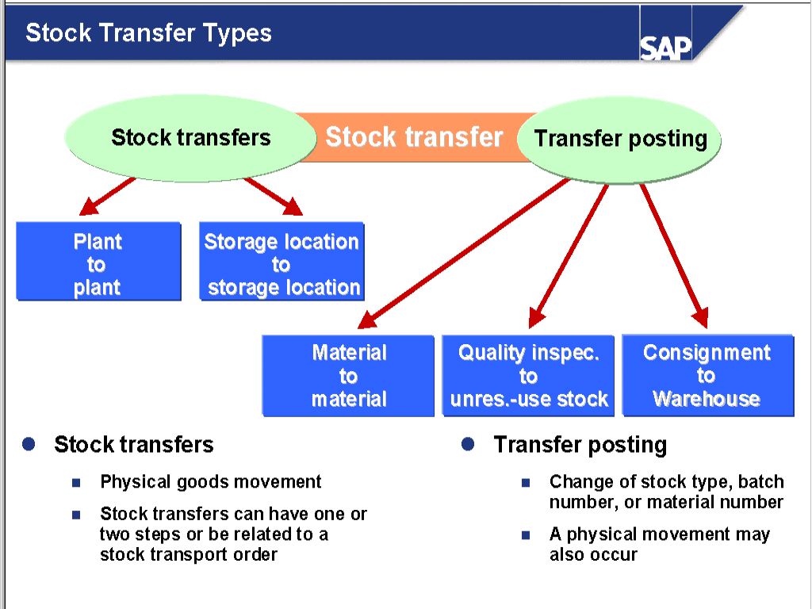
5. Inventory Management
Stock Transfers
Notes:
Unlike stock transfers, transfer postings do not usually involve a physical goods movement, but a change in stock type, batch number, or material number.
Examples of transfer postings include release from quality inspection or transfer from consignment material to your company’s own stocks.
The R/3 System creates a material document so that the transaction can be entered. Documents in Financial Accounting (FI, CO, CO-PC) are created only if there is a stock change involving valuation (for example, goods are transferred from one plant to another).
You can also carry out stock transfers with reference to the purchase order. The entire process is explained in the training course LO925 Cross-Application Business Processes in SD and MM.

Slide 48
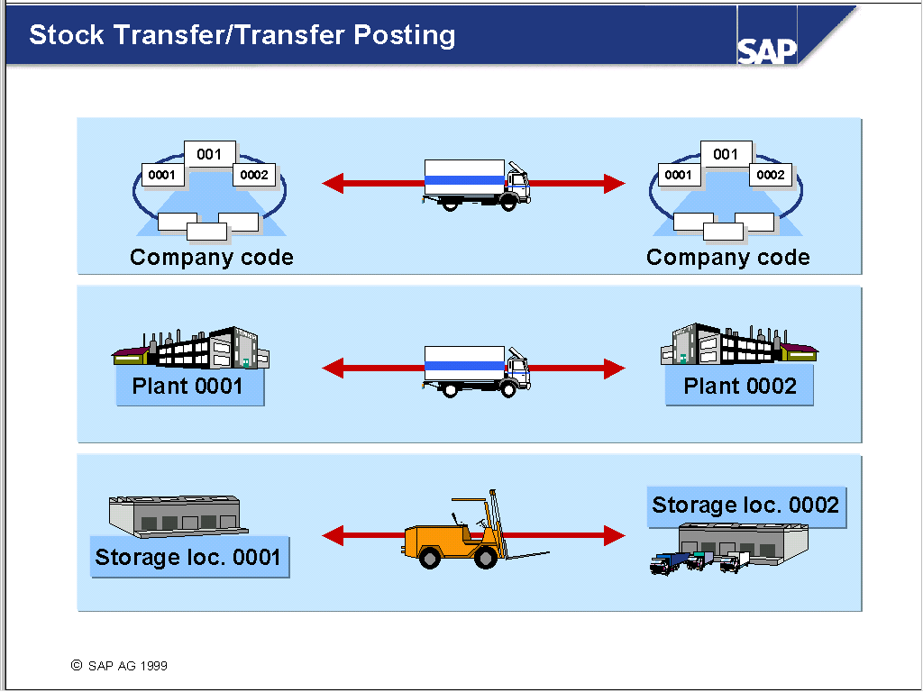
5. Inventory Management
Stock Transfers / Transfer Postings

Slide 49
5. Inventory Management
Storage Location to Storage Location Transfer

Slide 50
5. Inventory Management
Plant to Plant Transfer

Slide 51
5. Inventory Management
Material to Material Transfer

Slide 52
5. Inventory Management
Transfer Posting

Slide 53
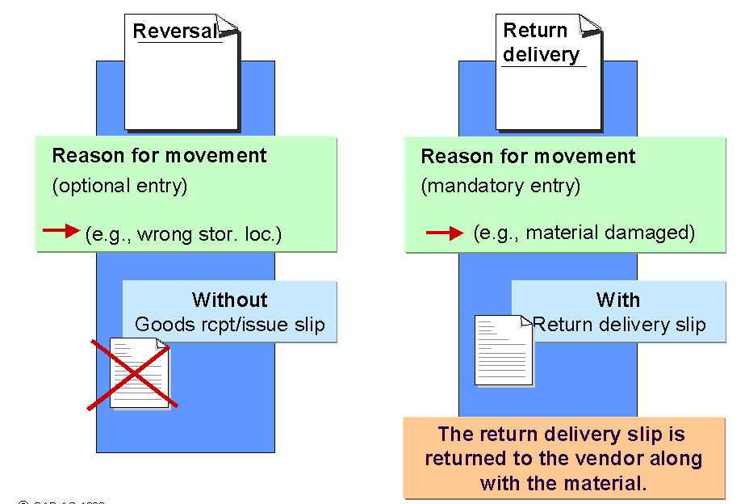
5. Inventory Management
Reversals & Return Deliveries
Notes:
Whether a goods receipt/issue slip or a return delivery slip is to be printed can be made dependent on the movement type.
The “reason for movement” specified can also be determined per movement type. The “reason for movement” enables an analysis and display of vendor problems (for example, damaged packaging).
When returning material to a vendor, you can specify a reason for movement individually for each item or enter a reason for movement on the initial screen for goods movements.

Slide 54
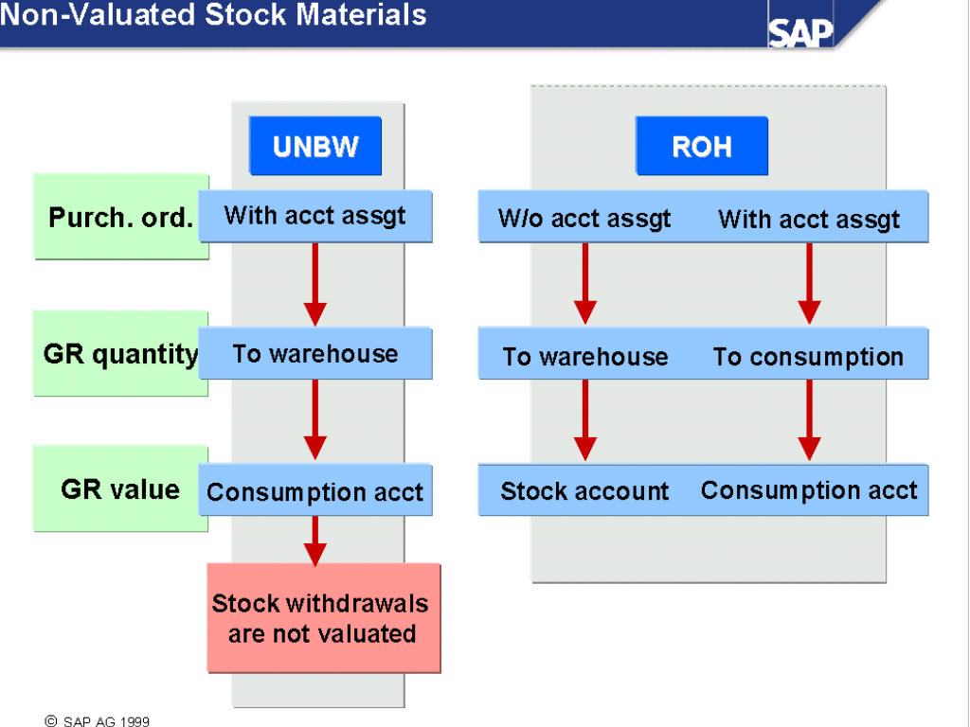
5. Inventory Management
Non valuated Stock Material
Notes:
You manage low-value advertising or office materials in a warehouse, and can get an up-to-date report on stock levels at any time. Stock records are kept on a quantity basis, but the value is posted to a consumption account at the time of goods receipt. In cases such as this, you use the material type UNBW.
The purchase order must have an account assignment, even if the material is only managed on a quantity basis. This does not mean that the goods receipt is posted to consumption according to quantity, but rather that the costs are debited to the account assignment.
You cannot post a goods receipt of non-valuated material directly into consumption. You have to post the goods into the warehouse first and then enter the goods issue.

Slide 55
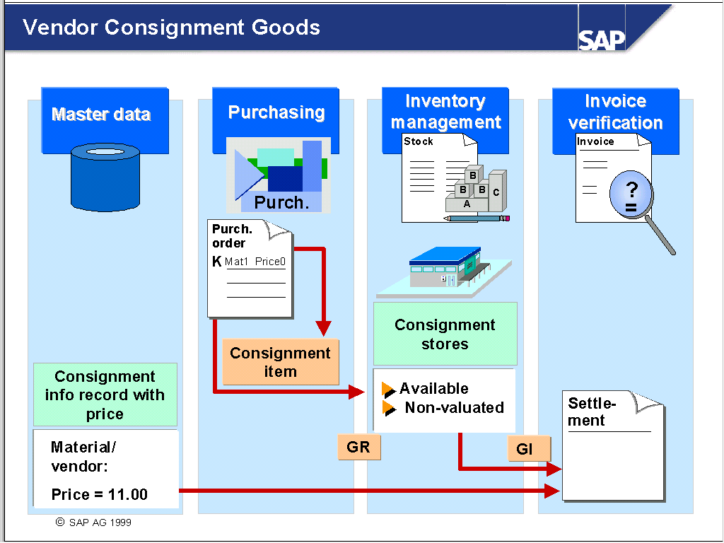
5. Inventory Management
Vendor Consignment Process
Notes:
The vendor provides goods that are stored in consignment stores. The vendor remains owner of the material until you withdraw materials from the consignment stores.
The vendor is informed of material withdrawals on a regular basis.
The quantity withdrawn is invoiced at certain time intervals.

Slide 56
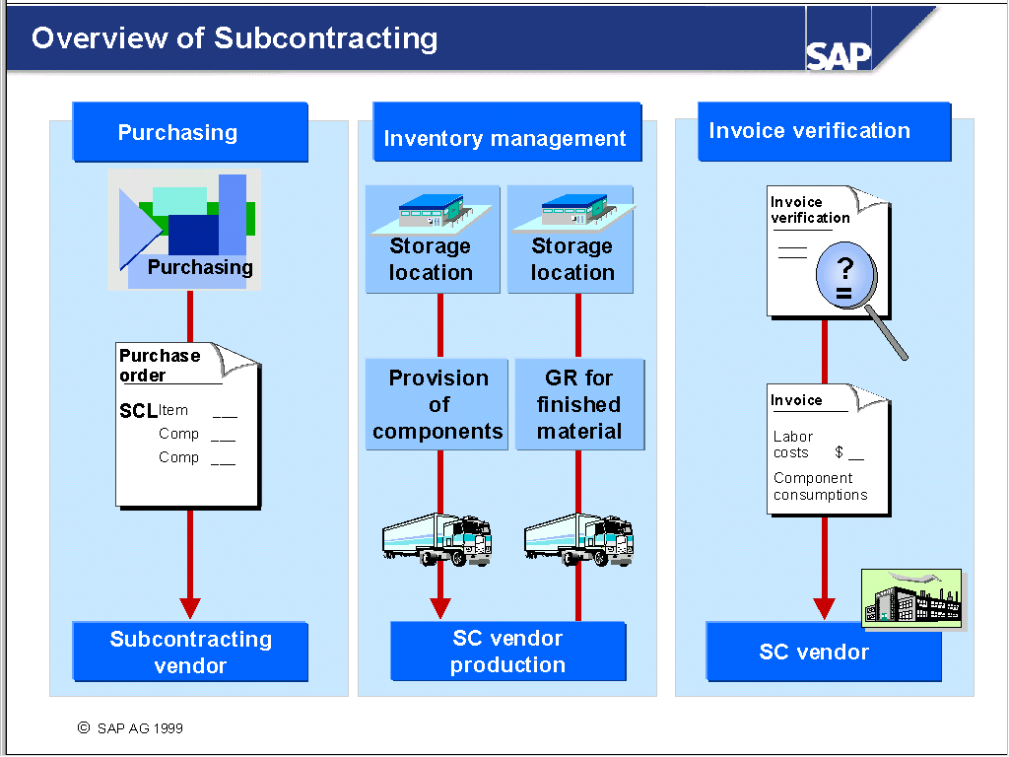
5. Inventory Management
Subcontracting Process
Notes:
You order the end product from a vendor, and specify in the purchase order which components you will send the vendor to manufacture the end product.
You issue the components to the vendor, and create a goods receipt for the product manufactured by the vendor. At the same time, the consumption of the components is posted.
The vendor's invoice is entered with reference to the purchase order. A subsequent adjustment for excess consumption or under-consumption of the components can also be made at the same time.

Slide 57
5. Inventory Management
Physical Inventory
Procedure :
Periodic
Cycle Counting
Ad-hoc
Process :
Preparation
Create Physical Inventory Document
Block material for posting
Print & distribute Physical Inventory Document
Physical Inventory Count
Physical Inventory Analysis
Enter the result into the system, recount if necessary, posting the difference.
Notes:
Inventory Sampling The more stock management units a company has in its warehouse, the more complicated a physical inventory of the entire stock becomes. Time and cost can be reduced by determining the stock of select materials, then using the count results to make a projection for all stock management units. The method of inventory sampling is based on this principle. It is a procedure that can be used in both Inventory and Warehouse Management.
Cycle Counting Cycle counting is a method of physical inventory where inventory is counted at regular intervals within a fiscal year. These intervals (or cycles) depend on the cycle counting indicator set for the materials. Cycle counting allows fast-moving items to be counted more frequently than slow-moving. The R/3 Inventory Management system offers functions designed for the sole purpose of carrying out physical inventories. The procedures it supports are periodic inventory, continuous inventory, inventory sampling, and cycle counting.
How is the physical inventory process supported?
By all current physical inventory procedures
By functions designed purely for processing physical inventories
By integration with Materials Management (material master, stock quantities)
By a link to Financial Accounting (posting of difference values)

Slide 58
INDEX
1
Objective
2
Materials Management Overview
3
Master Data
4
Procurement
5
Inventory Management
6
Batch Management
7
Serial Number Management
8
Invoice Verification

Slide 59
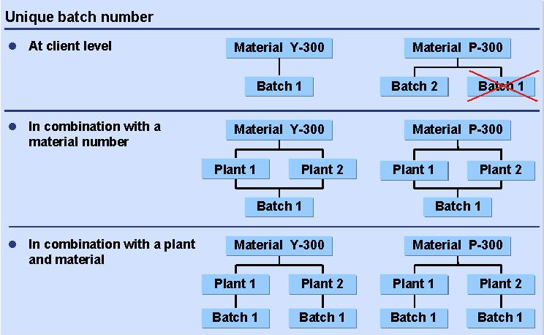
6. Batch Management
What is Batch Management?
“A batch is a quantity of material representing a homogeneous unit with unique specifications. A Batch is a subset of the total quantity of a material held in stock”
Levels of Batch Uniqueness

Slide 60
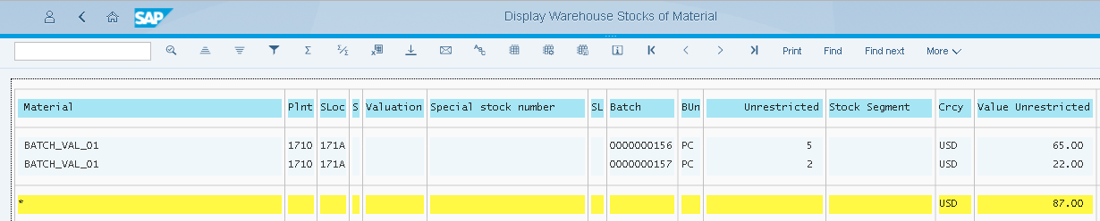
6. Batch Management
What does it mean to you?
Area | Implication
Material Master | Set Batch Managed Indicator
Goods Movement | Require batch number in EVERY transaction. Physical movement need to match system movement down to batch number level!
Physical Inventory | Count by Batches
Valuation | Each Batch CAN be valuated separately.

Slide 61
INDEX
1
Objective
2
Materials Management Overview
3
Master Data
4
Procurement
5
Inventory Management
6
Batch Management
7
Serial Number Management
8
Invoice Verification

Slide 62
7. Serial Number
What is Serial Number Management?
You use Serial Numbers to identify and differentiate between individual items of material. A material master record may contain all data for describing and managing a piece of material, but this does not enable you to differentiate between individual items of that same material.

Slide 63
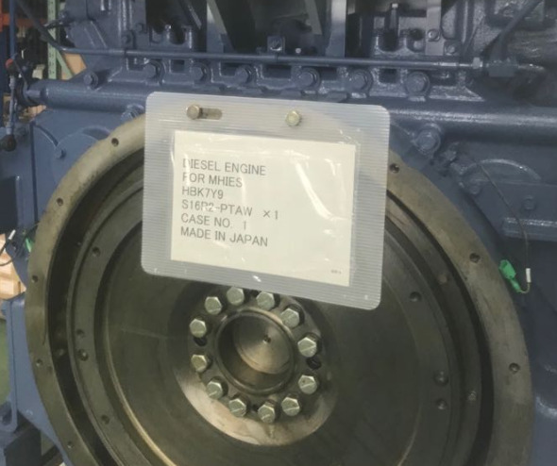
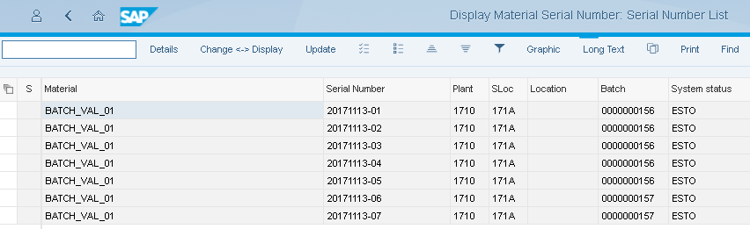
7. Serial Number
What does it mean to you?
Area | Usage
Material Master | Serial Number profile
Goods Movements | Enter the serial number accordingly
Physical Inventory | Count by Serial Number
Serial number master | Tracking of serial number history and status

Slide 64
INDEX
1
Objective
2
Materials Management Overview
3
Master Data
4
Procurement
5
Inventory Management
6
Batch Management
7
Serial Number Management
8
Invoice Verification

Slide 65
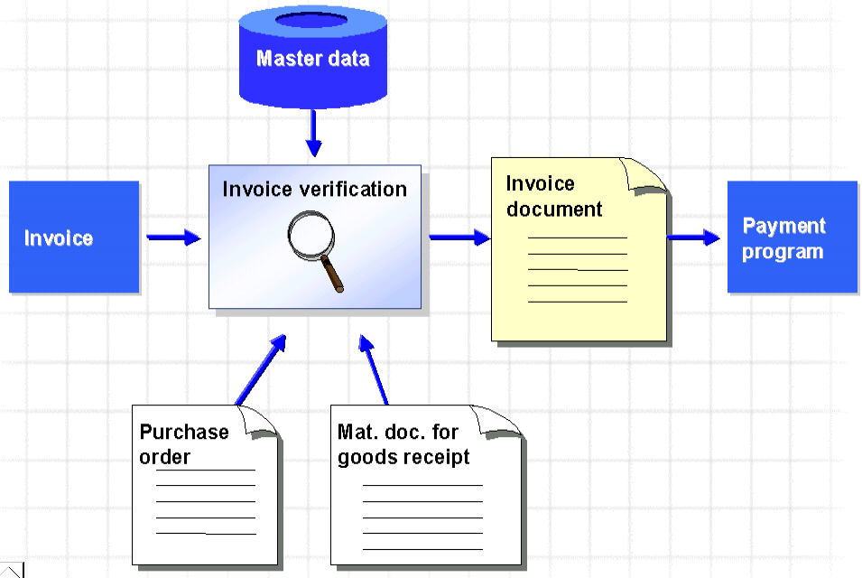
8. Invoice Verification
Invoice Processing

Slide 66
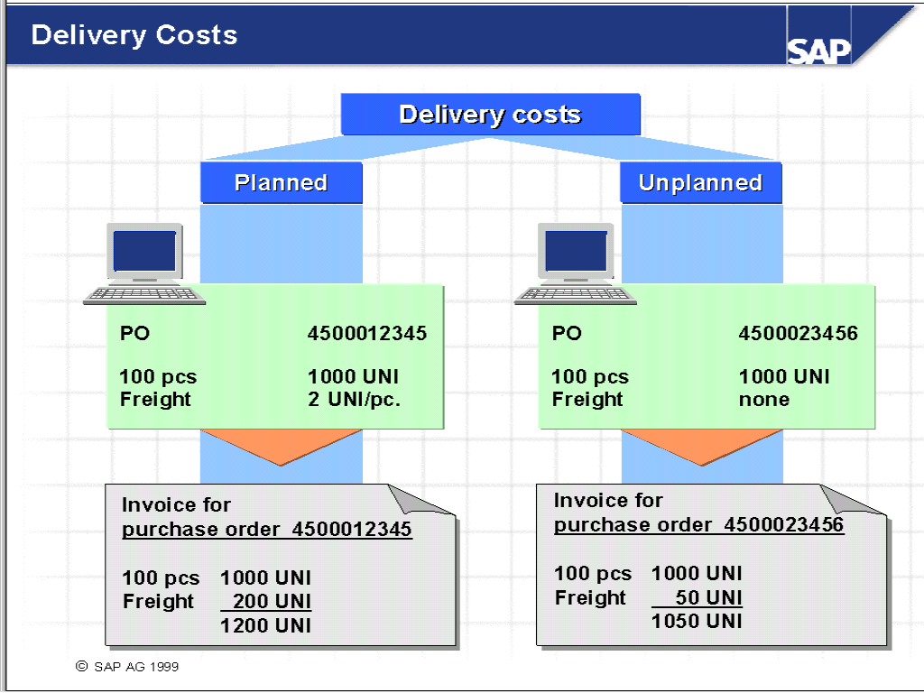
8. Invoice Verification
Delivery Costs
Notes:
Delivery costs can be divided into:
Planned delivery costs
Unplanned delivery costs
Planned delivery costs are entered at item level in the purchase order.
Unplanned costs are entered at invoice receipt.

Slide 67
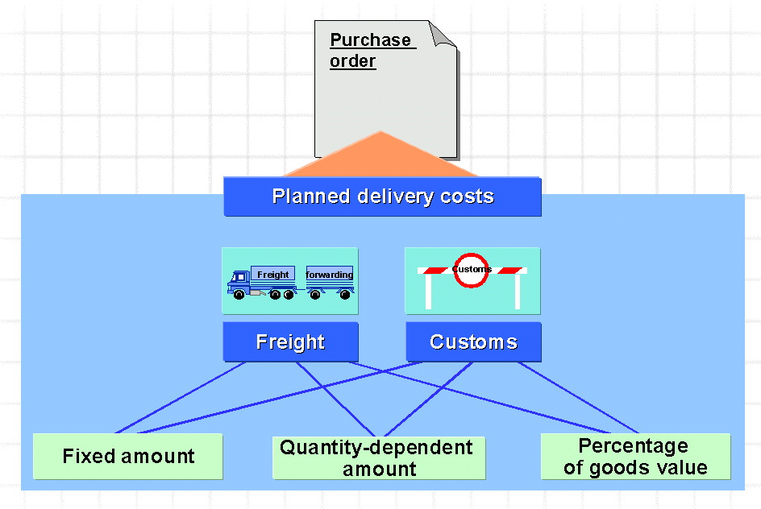
8. Invoice Verification
Planned Delivery Costs
Notes:
Planned delivery costs can be divided into:
Freight costs
Customs
Delivery costs can be invoiced in the following ways:
Fixed amount, independent of scope of supply
Quantity-dependent amount
Percentage of value of goods to be delivered

Slide 68
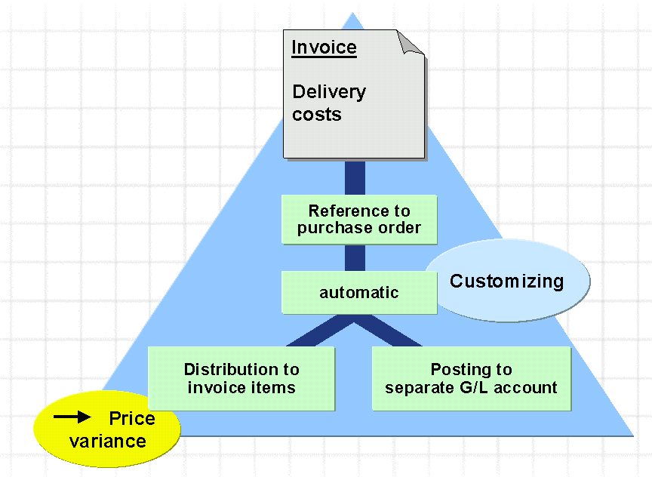
8. Invoice Verification
Un-Planned Delivery Costs
Notes:
In Customizing for Invoice Verification, you configure whether the R/3 System is to distribute unplanned delivery costs among the items or post the costs to a separate G/L account.
If the R/3 System distributes unplanned delivery costs among the items, it treats them in the same way as price differences. However, it does not check the price after distributing the delivery costs.
If the R/3 System distributes unplanned delivery costs among the items, it does not list them separately in the purchase order history. They are only included in the invoiced value.
If the R/3 System posts unplanned delivery costs to a separate G/L account, they do not appear in the purchase order history.

Slide 69
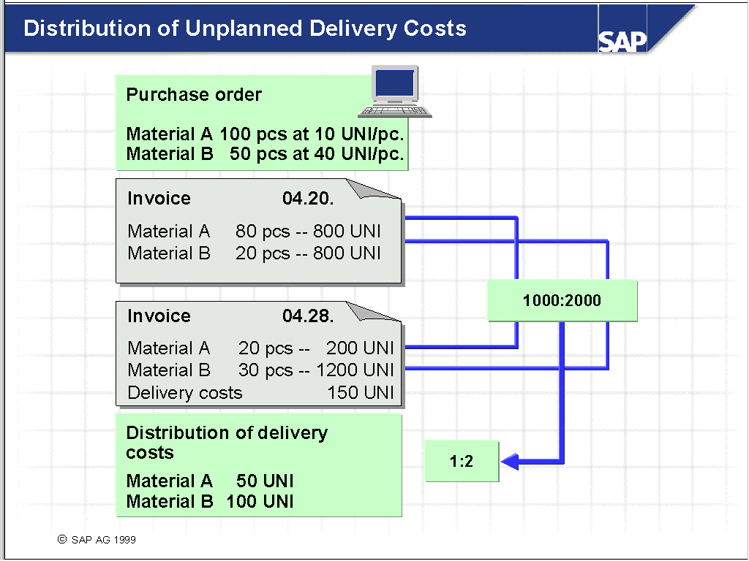
8. Invoice Verification
Distribution of Un-Planned Delivery Costs
Notes:
The R/3 System apportions unplanned delivery costs to the items in proportion to the total value invoiced so far and the values in the current invoice.
If the R/3 System is to distribute unplanned delivery costs to the invoice items, you can post an invoice solely for delivery costs only if you have already posted an invoice.

Slide 70
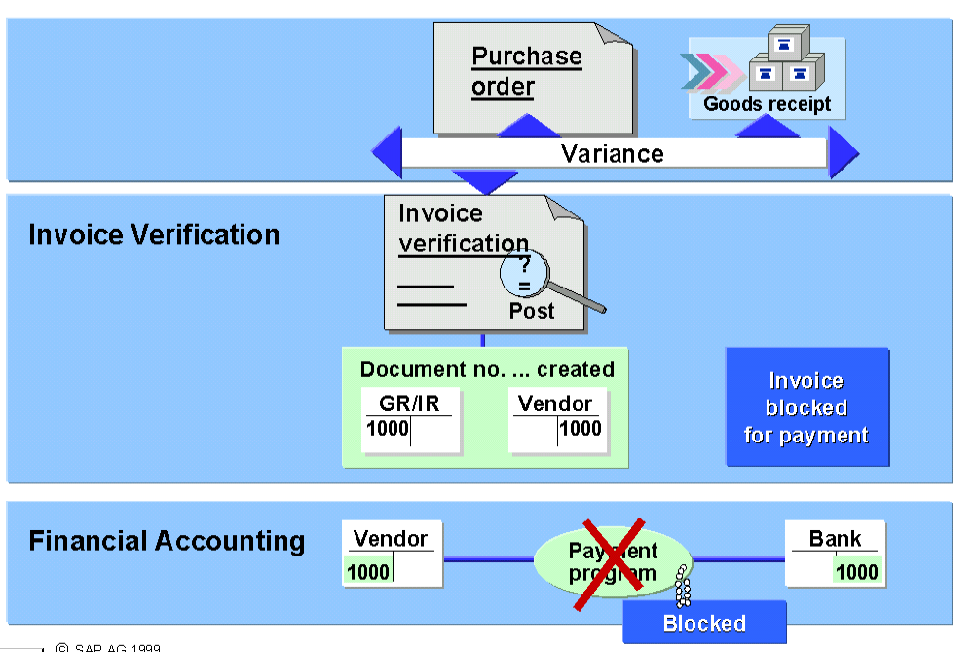
8. Invoice Verification
Blocked Invoice
Notes:
If an invoice is blocked for payment when you post it, the field Payment block is selected in the vendor line item of the invoice document. Financial Accounting is then unable to pay the invoice automatically.
An invoice is blocked for one of the following reasons:
Automatically due to variances in an item
By entering a payment block manually
By stochastic blocking
A blocked invoice must be released for payment in a separate step, possibly after consultation with the purchasing department or the vendor. This deletes the payment block.

Slide 71
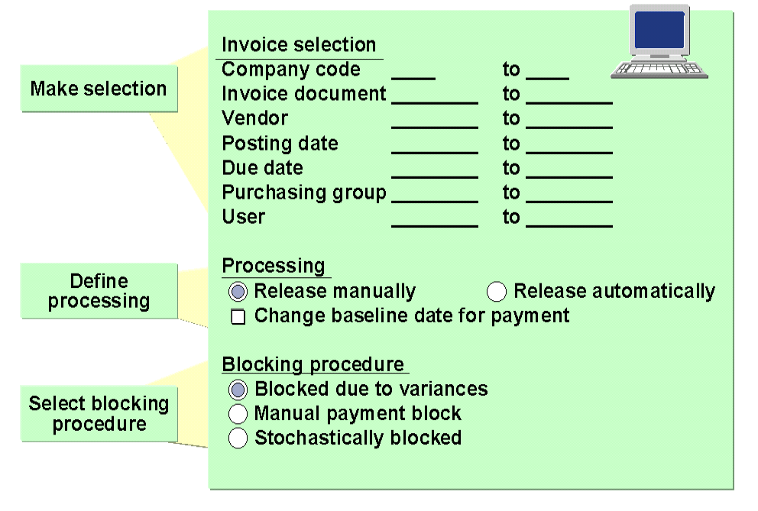
8. Invoice Verification
Release Blocked Invoice
Notes:
Select the invoices that you want to process.
In the period between blocking and releasing an invoice, the cash discount period could expire. When you release an invoice, you have the opportunity to change the baseline date for payment. This extends the payment period when you release the invoice.
You can release automatically invoices that the R/3 System blocked due to variances.

Slide 72
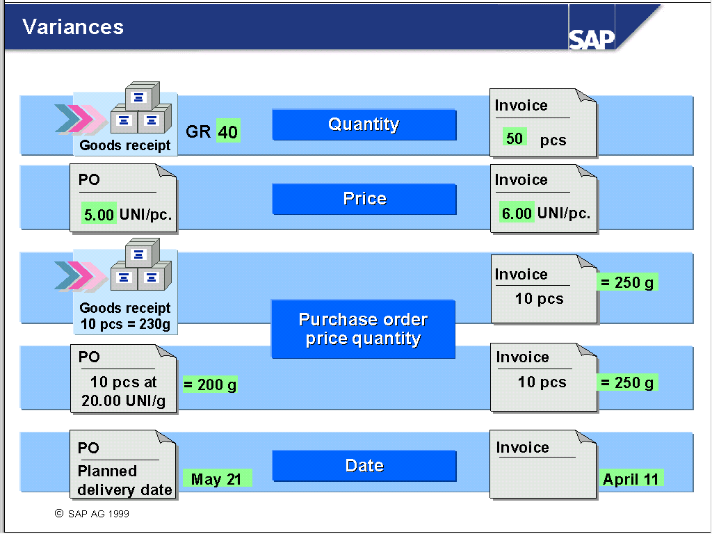
8. Invoice Verification
Variances
Notes:
The R/3 System makes the following checks for each invoice item:
Quantity variance
It compares the difference between the delivered quantity and the quantity already invoiced with the invoice quantity.
Price variance
It compares the purchase order price with the invoice price (invoice value / quantity).
Purchase order price quantity variance
Goods receipt before invoice receipt
The following ratios are compared: goods receipt quantity (in purchase order price units) / goods receipt quantity (in purchase order units), invoice quantity (in purchase order price units) / invoice quantity (in purchase order units).
Invoice receipt before goods receipt
The following ratios are compared: purchase order quantity (in purchase order price units) / purchase order quantity (in purchase order units), invoice quantity (in purchase order price units) / invoice quantity (in purchase order units).
Date variance
The R/3 System compares the planned delivery date to the invoice entry date.

Slide 73
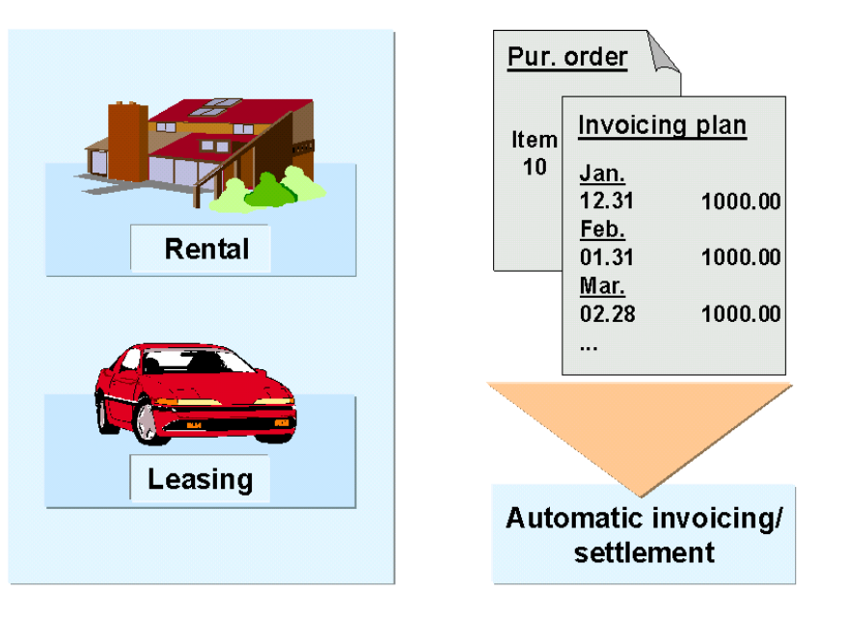
8. Invoice Verification
Period Invoicing Plan
Notes:
As of Release 4.0A, you can create purchase order items with an invoicing plan. An invoicing plan consists of a series of invoicing dates and values and forms the basis for the mainly automatic creation and settlement of invoices.
PO items with an invoicing plan are suitable for recurrent procurement transactions (such as rental, leasing, servicing agreements) or for transactions involving settlement in stages.
There are two kinds of invoicing plans: “periodic” and “partial”.
The periodic invoicing plan should be used for recurrent procurement transactions. With this type of invoicing plan, the total value of the PO item is invoiced on each due date. The due dates can be suggested by the R/3 System.
The invoicing plan type is defined in Customizing and is assigned in the PO item.

Slide 74
8. Invoice Verification
Partial Invoicing Plan
Notes:
There are two kinds of invoicing plans: “periodic” and “partial”.
The partial invoicing plan should be used for transactions involving invoicing and payment in stages (for example, in construction projects, where a down payment is required). With this type of invoicing plan, the total value of the item is spread among the individual due dates defined in the invoicing plan. Thus, only a part of the total item value is payable on each due date.
In the case of the partial invoicing plan, the due dates can be suggested by the R/3 System only if date proposals are first defined in a model invoicing plan in Customizing for simplification purposes. Otherwise, the due dates have to be entered manually at when the purchase order item is created.
The total value of the PO item can be split among the due dates on a percentage basis or in absolute amounts.
Automatic invoicing is based on the dates and values specified in the invoicing plan assigned to the PO item.
The invoicing plan type is defined in Customizing and assigned in the PO item.

